Slide 1
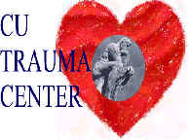

Qualitative Research Methods
Mary H. Hayden, PhD
NCAR Summer WAS*IS
July 20, 2006

Slide 2
Presentation Outline
Distinguishing qualitative and quantitative approaches
Qualitative methods –
  Types of qualitative methods
  Advantages vs. Disadvantages
Real World Examples

Slide 3
Qualitative and Quantitative Approaches
Qualitative | Quantitative
(Usually) Non-probability based sample | Typically a probability-based sample
Non-generalizable | Generalizable
Answers Why? How? | Answers How many? When? Where?
Formative, earlier phases | Tests hypotheses, latter phases
Data are “rich” and time-consuming to analyze | Data are more efficient, but may miss contextual detail
Design may emerge as study unfolds | Design decided in advance
Researcher IS the instrument | Various tools, instruments employed

Slide 4
Qualitative “vs.” Quantitative?
Research question guides the choice
Choice of methods is situational
Complementary
  Research more complete with both
Each requires resources and time
  Can be amended for rapid analysis
Notes:
Simple questions of how often do you listen to NOAA weather radio? Where do you go for shelter when a tornado warning is issued? Quant.
How do you think the weather service could better warn you of an impending tornado? Why would you ignore a weather warning?

Slide 5
Types of qualitative methods

Slide 6
Interviews
Informal – researcher is required to recollect discussion
Unstructured – e.g. ethnographic interviewing – researcher allows interview to proceed at respondent’s pace and subjects to vary by interviewee (to an extent)
Semi-structured – researcher uses an interview guide
Structured – researcher uses identical stimuli and adheres to interview schedule

Slide 7
Semi-structured Interviews

Slide 8
Focus Groups
Recruited to discuss particular topic
One focus group is ONE unit of analysis
Complement surveys – often the 1st step in tapping critical questions to be used in a survey
Identify why people feel certain way and elucidate steps in their decision-making process
Notes:
How do you know what questions to ask in your survey? How do you know that they are realistic and that people consider them important or answerable?

Slide 9
Focus Group Methods
Ideal size: 6 – 12 people and a moderator/note taker
Series of groups is necessary for validity
Homogeneity and anonymity in selection of groups
  people may open up with others who are perceived to think along similar lines AND whom they may never see again
Notes:
We have conducted formal focus groups where we set up the group before we arrive in a town, and we have conducted intercept groups. For example, in Tijuana, we gathered together a group of people who were waiting for family or friends to be seen by a doctor in a local clinic. In Tucson, we also spend a lot of time in immunization or community clinics and often gather groups who are waiting in line.

Slide 10
Focus Group Methods, cont.
Often segment according to expected meaningful differences (e.g. disease status, gender…)
Running a focus group – fine line between leading too much and not getting people to contribute
Important to keep discussion on topic w/o shutting people down
No right or wrong answers

Slide 11
Focus Group Methods, cont.
Coding/Analyzing
Tapes are usually transcribed verbatim
Text is sorted into emergent themes by at least 2 researchers to ensure validity using pile-sort method or computerized version such as CDC’s EasyText (free!)
Themes are compared with field notes taken by second researcher
Notes:
Pile Sort:
Researchers literally sort responses into themes, and pile them up on a table to validate emergent themes based on 4 thematic coding factors.
Software options
Can aid in organizing text
Especially critical when there are multiple interviewers
Still need interviewers to help interpret the pauses, body language, dominance of particular speakers

Slide 12
Focus Group Methods, cont.
Thematic coding factors:
1. Frequency – number of times something is mentioned
2. Specificity – details
3. Emotion – enthusiasm, passion, etc. in responses
4. Extensiveness – how many different people said something

Slide 13
Structured Interviews

Slide 14
Questionnaires
Three methods:
Face-to-face interviews
Self-administered questionnaires
Telephone interviews

Slide 15
Face-to-Face Interviews (and intercept interviews)
Advantages:
Can be used with respondents who wouldn’t be able to provide information in another format – bedridden, illiterate, etc.
Researcher can elicit more in-depth response or fill in information if participant doesn’t understand the question
Different data collection techniques – open-ended questions, visual aids, etc.
Certainty about who answered the questions

Slide 16
Face-to-Face Interviews, cont.
Disadvantages:
Intrusive and reactive
Cost time and money
Difficult to locate respondents for callbacks

Slide 17
Self Administered Questionnaires
Advantages:
Post Office locates participants
Everybody gets the same questions
Researcher can ask more complex questions
No response effect (willing to divulge more info w/o face-to-face contact; less likely to try to impress interviewer
Can be computer-based

Slide 18
Self Administered Questionnaires, cont.
Disadvantages:
No control over participant interpretation
Low response rates
Uncertainty about who actually filled out the questionnaire
Useless with non-literate, illiterate populations (same problem with English language sampling) or hard-to-reach populations

Slide 19
Telephone Interviews
Advantages:
Combo of face-to-face personal quality with impersonal self-administered questionnaires
Inexpensive and convenient (maybe)
Safe for interviewers

Slide 20
Telephone Interviews, cont.
Disadvantages:
Changing demographics – more cell phones?
  May miss certain population segments
Survey must be short or people will hang up
“No Call Lists” presenting increasing challenge

Slide 21
Focus Groups vs. Surveys
Surveys offer quantitative measurements based on a representative sample
Focus groups offer content insight – the why of what people think

Slide 22
Real World Examples
West Nile Virus (WNV) focus group research in CO in 2003
11 semi-structured focus group interviews were conducted
  Groups were recruited through community gatekeepers and composed of participants from senior centers, health departments, neighborhood and volunteer organizations and local businesses
Purpose was to explore and contextualize use/non-use of repellent and KAP around WNV and mosquitoes in CO

Slide 23
Real World Examples
WNV in Colorado – Selected results
  CO residents didn’t perceive mosquitoes to be a problem in the “high plains”
  The high proportion of WNV Fever cases diagnosed in some areas led to perception that “everyone was sick” and higher levels of concern
  Younger people wanted to get infected before risk of neuroinvasive disease increased
  Residents perceived that media overplayed the issue

Slide 24
Real World Examples
Border Research
  WNV focus group research in Imperial Valley along MX/CA border in 2004
  WNV focus group research in Tijuana/San Diego in 2005
  Traditional surveys would be especially difficult due to international agreements, lack of phones, lack of sampling framework, inability to contextualize responses with neighborhoods

Slide 25

Methods
Topics Covered
  Knowledge about WNV
  Sources of information
  Perceptions re presence of mosquitoes
  Actions to avoid/kill mosquitoes/prevent bites
    Repellent, chemicals, household control
  Existence of health committees or health information in local area

Slide 26
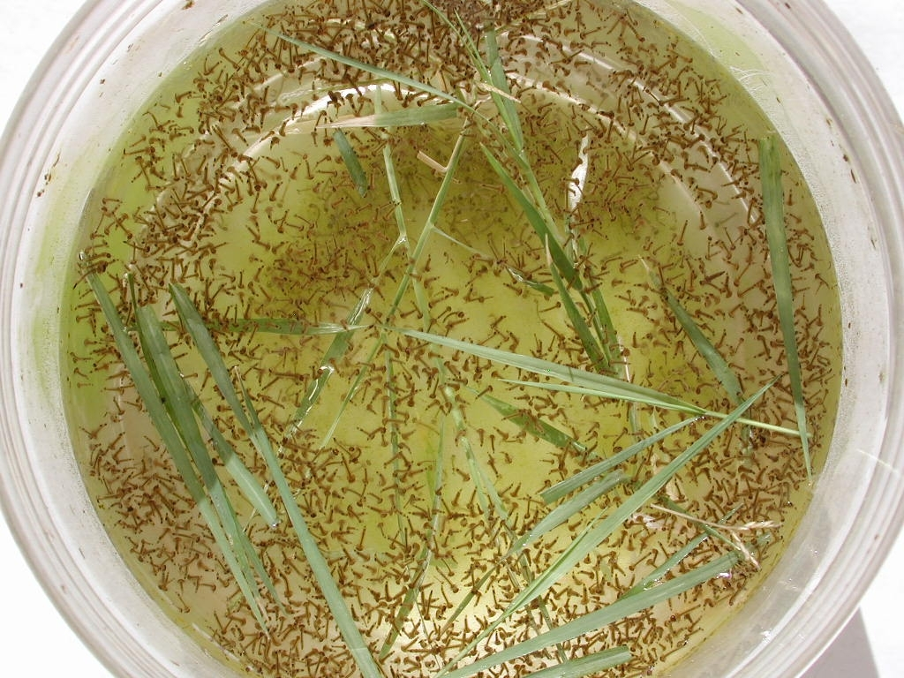
Results
Household control of breeding sites - Most people familiar with “control of standing water”
  Varied understandings of “standing water”
Many Culex breeding sites beyond means of household control—related to irrigation and/or sewage canals

Slide 27

Results—Information Sources
Media most frequently cited as source by those who knew of WNV
Spanish speakers in US may not be accessing local news
  Many report primarily watching satellite channels from Mexico
Imperial County (for example) challenged by lack of local stations

Slide 28
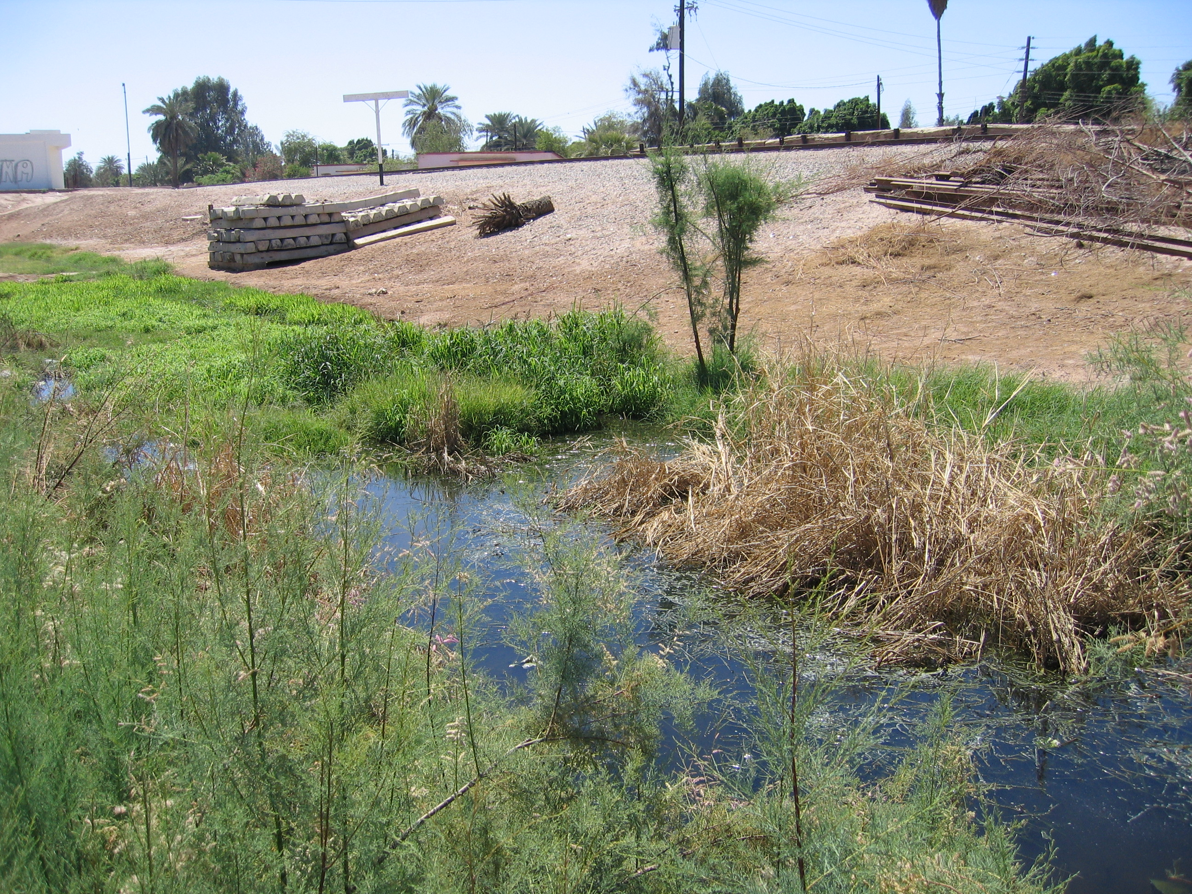

Slide 29
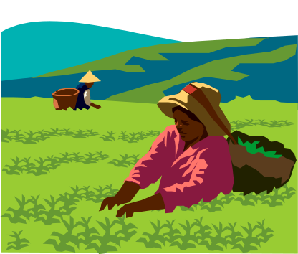
Results—Special Populations
Needs and risks among agricultural workers (US) could be significant during an outbreak, especially among undocumented workers if unlikely to seek medical care
Need approaches for non-English and non-Spanish speakers
Migrant laborers unlikely to have access to television, mail, etc.

Slide 30
Sample Survey Questionnaire Critique
While surveys are a strong and popular method, the following are some examples of questions where a closed response may present significant limitations

Slide 31
Katrina Questionnaire Critique
Tell me all the places you saw or heard information about the hurricane before Katrina.
Environmental cues (look outside)
Family or friends
The Weather Channel
Internet
Local radio stations
Local television stations
NOAA Weather Radio
Cell Phone
Other (please describe) __________________________________________
Notes:
Missing options, time sensitive (different info at different times), no one knew what NOAA weather radio was, really

Slide 32
Katrina Critique, cont.
Before Katrina, how serious did you think the hurricane and its consequences would be?
□ Very serious □ Moderately serious
□ A little serious □ Not serious at all
Notes:
For me, for my city? Again the hurricane or the aftermath?

Slide 33
Katrina Critique, cont.
Do you think that you will stay in this area (shelter community)?
□ YES □ NO
Notes:
Again time frame, doesn’t accommodate “it depends’

Slide 34
Katrina Critique, cont.
Should this shelter need to close would you be willing to move another shelter?
□ YES □ NO
Notes:
Some people said “like I have a choice?”

Slide 35
Dengue Questionnaire Critique
Do you travel back and forth between the US and Mexico?
□ YES □ NO
If so, number of days per year?
Notes:
Does not address issues with time of day, activity in MX that might expose people to mosquitoes, whether they remain in Mexico for an extended period of time – where they are going in MX (dengue endemic or not)

Slide 36
Dengue Critique, cont.
Do you have piped water 24 hours/day?
□ YES □ NO
If no, do you store water in an open container?
□ YES □ NO
Notes:
Does not address whether they actually have running water – does not really capture what is meant by ‘open container’

Slide 37
Dengue Critique, cont.
Do you have screens on all windows and doors?
□ YES □ NO
Notes:
Doesn’t address condition of screens – other problems with doors is that they open – do they open inward or outward might be a more interesting question…….

Slide 38
Summary
Qualitative data gathering is a rich and important tool in some settings
Variety of methods available
May overcome limitation of closed survey questions and assist in development of better instruments

Slide 39
References
Bernard, HR. (2002) Research Methods in Anthropology: Qualitative and Quantitative Approaches. Walnut Creek: AltaMira Press
Krueger, RA and Casey, MA. (2000). Focus Groups: A Practical Guide for Applied Research. Thousand Oaks: Sage Publications
Puchta, C. and Potter, J. (2004) Focus Group Practice. London: Sage Publications
Zielinski-Gutierrez EC and Hayden MH. (2006) A model for defining West Nile virus risk perception based on ecology and proximity. EcoHealth 3(1): 28-34

